Slide 1
Feed Me Better

Slide 2
Hello!
We are Feed me Better
An app that helps monitors your diet and calories intake
Not just that, we give healthier alternatives!!
Notes:
An app that not only helps monitors your diet and calories intake, but also provides healthier alternatives. The app can also serve as a social platform that users can share their own diet food and ask the nutritionists for advice.

Slide 3
Mission
Help create a world with less pain of illness where people can see a fitter and better self, and people can live healthily and happily

Slide 4
Technology
Core ML
A new foundational machine learning framework delivered by Apple
Neural Network
Big data (Pre-trained)
More than 20,000 food objects
Notes:
We implemented Core ML Neural Network classifier with more than 2,000 pre-trained food image recognition model to identify the food and calculate the calories.

Slide 5
Demo

Slide 6
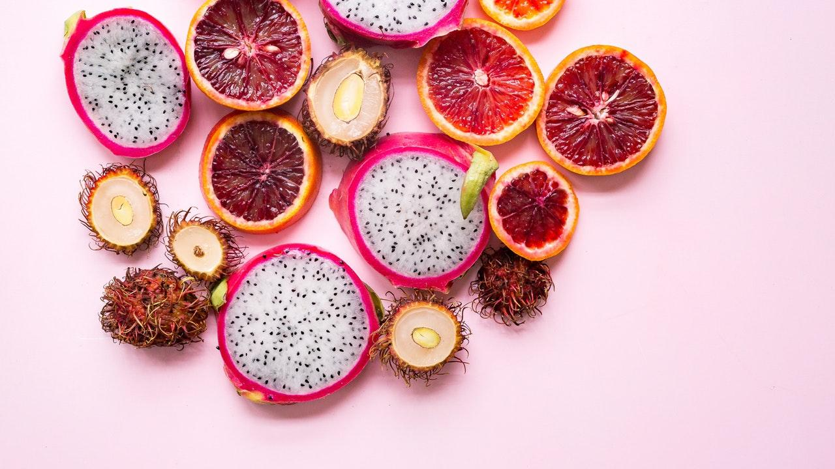
Business Model
Users
༝ BMI < 25
༝ BMI >= 25
Clients
༝ Nutrition Consultancy
༝ Gym Coach
༝ Restaurant

Slide 7
Thank you AngelHack, AWS, sponsors and others!
Any questions?

